Slide 1

DEPARTMENT OF INFORMATION TECHNOLOGY
Final Review
Ranking of Products using Opinion Mining on Authentic Reviews
Supervisor
Prof.A.K.Mariappan
M.E., (Ph.D)
Department of IT
Project by
Abhishek Balaji V S(310611205001)
Barath Sriram R(310611205011)
R.Dhanya(310611205018)
IV th Year,IT-A

Slide 2
Ranking of Products using Opinion Mining on Authentic Reviews
OUTLINE
Objectives
Abstract
Detailed design of the proposed system
Software Used
Code Implementation snapshots
Intermediate results obtained
References
Dept. of IT, Easwari Engineering College
2
Notes:
2
2

Slide 3
Ranking of Products using Opinion Mining on Authentic Reviews
OBJECTIVES
To perform opinion mining on authentic reviews from social media and various sites.
To rank the popularity of products based on these customer reviews.
Dept. of IT, Easwari Engineering College

Slide 4
Ranking of Products using Opinion Mining on Authentic Reviews
ABSTRACT
E-Commerce is rapidly growing and large number of products are sold online. Hence, customers go for a product based on the ranking of products. It is therefore important to genuinely rank products for which we first need to authenticate reviews and rank the products based on such reviews after review cleaning and analysis. Our proposal makes the ranking more reliable by taking authenticity into account. Also we consider data from social media which are the direct views of consumers and enables us to notch reliable ranking.
Dept. of IT, Easwari Engineering College

Slide 5
Ranking of Products using Opinion Mining on Authentic Reviews
INTRODUCTION
Text mining, also referred to as text data mining, roughly equivalent to text analytics, refers to the process of deriving high-quality information from text. High-quality information is typically derived through the devising of patterns and trends through means such as statistical pattern learning.
Much of the text mining works focus on information retrieval and text pattern recognition.
Sentiment analysis is a hot research problem in the text mining.
Sentiment analysis refers to the identification of user’s sentiment on a product or a topic such as a movie.
Dept. of IT, Easwari Engineering College

Slide 6
Ranking of Products using Opinion Mining on Authentic Reviews
TEXT DATA IN E-COMMERCE
Textual information is classified into two broad types: facts and opinions.
Opinions vary from person to person even for the same thing such as a product or movie.
E-commerce is growing rapidly and large number of products are sold online.
Growth of e-commerce has resulted in huge amount of user-generated content in the form of reviews.
For a particular product, large number of reviews are available in e-commerce sites.
Dept. of IT, Easwari Engineering College

Slide 7
Ranking of Products using Opinion Mining on Authentic Reviews
OPINION MINING
Opinions are available across several sources in the Web.
The review text usually has two kinds of text:
Opinionated text
Factual text
Humans may find it difficult to identify the opinion sources, extract sentences with opinionated text, read them and organize them into usable forms.
Hence, opinion mining is done on these user-generated content to identify the subjective information in the text.
Opinion mining refers to the use of NLP techniques to identify the important aspects and subjective information in the opinions such as user reviews.
Sentiment analysis ( opinion mining ) is done at document level or sentence level.
Dept. of IT, Easwari Engineering College

Slide 8
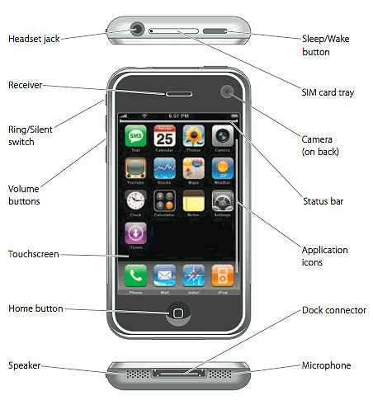
Ranking of Products using Opinion Mining on Authentic Reviews
EXAMPLE REVIEW
“I bought an iPhone a few days ago. It was such a nice phone. The touch screen was really cool. The voice quality was clear too. Although the battery life was not long, that is ok for me. However, my mother was mad with me as I did not tell her before I bought the phone. She also thought the phone was too expensive, and wanted me to return it to the shop”
In this review, we can find that usually reviews focus on particular aspects of the product. So, it is important to perform feature based sentiment analysis.
Dept. of IT, Easwari Engineering College

Slide 9
Ranking of Products using Opinion Mining on Authentic Reviews
FEATURE BASED SENTIMENT ANALYSIS
Feature1: Touch screen
Positive:
The touch screen was really cool.
The touch screen was so easy to use and can do amazing things.
…
Negative:
The screen is easily scratched.
I have a lot of difficulty in removing finger marks from the touch screen.
…
Feature2: battery life
Dept. of IT, Easwari Engineering College

Slide 10
Ranking of Products using Opinion Mining on Authentic Reviews
PRODUCT RANKING
Large number of products are available in each category. Hence we need ranking to select the best product.
We propose a ranking system using opinion mining on the product reviews from multiple e-commerce sites.
We consider the reviews of people who have actually purchased the products. These reviews are most likely to contain less spam and more utility.
However we find that some of these reviews also contain spam which will be explained later.
Dept. of IT, Easwari Engineering College

Slide 11
Ranking of Products using Opinion Mining on Authentic Reviews
DATA SET
Existing data sets are not used. We collect data from multiple e-commerce sites.
We have collected 27214 reviews consisting of 92231 sentences.
We designed our own crawlers for crawling the reviews from Amazon and Flipkart.
After the reviews are collected, we preprocess them to remove noisy data and stopwords.
Dept. of IT, Easwari Engineering College

Slide 12
Ranking of Products using Opinion Mining on Authentic Reviews
REVIEW PREPROCESSING
The reviews are split into sentences and stopwords are removed from these reviews.
Bad data such as spelling mistakes, noisy data are removed from the reviews. Spelling mistakes are corrected if possible.
Spam content such as reviews with unusual number of characters in a word are removed.
After that each word is tagged with a part-of speech using POS tagger.
Dept. of IT, Easwari Engineering College

Slide 13
Ranking of Products using Opinion Mining on Authentic Reviews
DETAILED DESIGN OF PROPOSED SYSTEM
Crawl reviews
User
User Interface
authentic
Review Database
Product type/feature as query
Check authenticity
Extract review elements
Refine reviews
Issue product ranks
Opinion Mining
Dept. of IT, Easwari Engineering College
13
Notes:
13
13

Slide 14
Ranking of Products using Opinion Mining on Authentic Reviews
SYSTEM ARCHITECTURE
In this system, we propose a framework where the user enters the specific product category and feature of the product in the user interface.
At the back end, the reviews are extracted; refined and mining of opinions are done using NLP and sentiment analysis for every review and aspect of the products.
Then the ranking is done and issued to the user. Also, while ranking the authenticity of reviews are considered.
Dept. of IT, Easwari Engineering College
14
Notes:
14
14

Slide 15
Ranking of Products using Opinion Mining on Authentic Reviews
SENTIMENT ANALYSIS PROCESS
We do static aspect extraction from the reviews and then find the sentences that have aspects such as touch, battery, memory and camera mega pixels, and store those sentences.
We use the aspects corpus from MPQC corpus to develop an aspect dependent sentiment lexicons to solve implicit aspect identification problem.
Based on a Naïve Bayes classifier trained by us, we classify the review sentences as positive or negative for a particular aspect.
Dept. of IT, Easwari Engineering College
15
Notes:
15
15

Slide 16
Ranking of Products using Opinion Mining on Authentic Reviews
SENTIMENT ANALYSIS PROCESS
All the sentences are classified as positive or negative or neutral using a sentiment classifier. We then find the average polarity of every individual review.
The aspect score for a product is calculated as follows:
n
Aspect score for a product = ∑ (­si) ­pos
i = 1
where si is the sentence in a review R for a product, (si) pos is the positive polarity score for the sentence si..
Dept. of IT, Easwari Engineering College
16
Notes:
16
16

Slide 17
Ranking of Products using Opinion Mining on Authentic Reviews
SOFTWARE USED
Languages used:
Python and Java
IDE used:
Sublime text 2
Python 2.7:
Python 2.7 is a fast , compliant implementation of the language .
There are many good reasons to choose Python as your primary programming language.
First of all Python is an easy to learn, powerful programming language.
Furthermore it has efficient high-level data structure, which allow you to write complex operations in fewer statements than in C, C++ or Java .
Python is very fast. The source code is compiled into byte code, so that executing the same file will be faster, if the script will be executed again.
The byte code is an "intermediate language", which is said to run on a virtual machine that executes the machine code corresponding to each byte code.
Importio API:
Importio was used to create a REST API for a self design given as an input.
Dept. of IT, Easwari Engineering College
17
Notes:
17
17

Slide 18
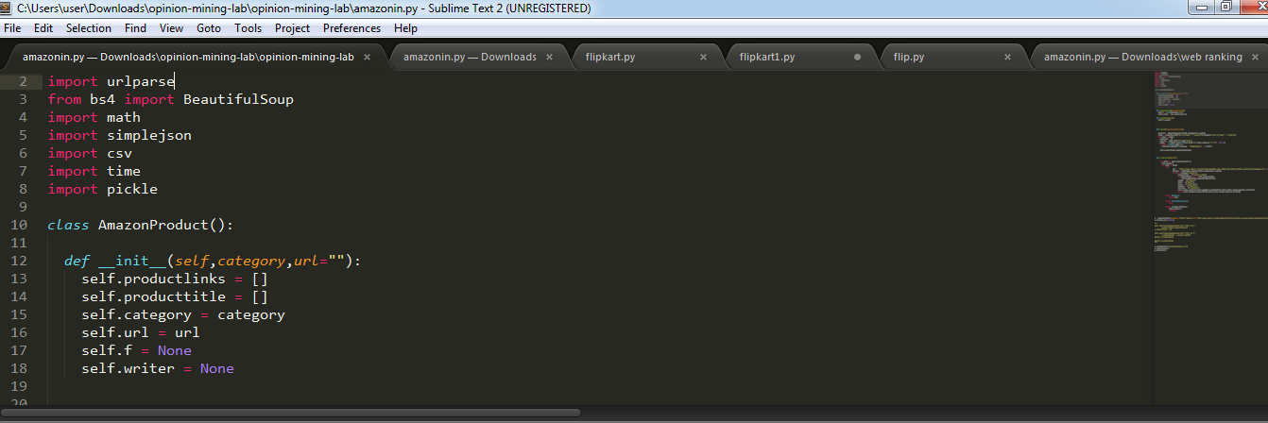
Ranking of Products using Opinion Mining on Authentic Reviews
CODE IMPLEMENTATION
Dept. of IT, Easwari Engineering College
18
Notes:
18
18

Slide 19
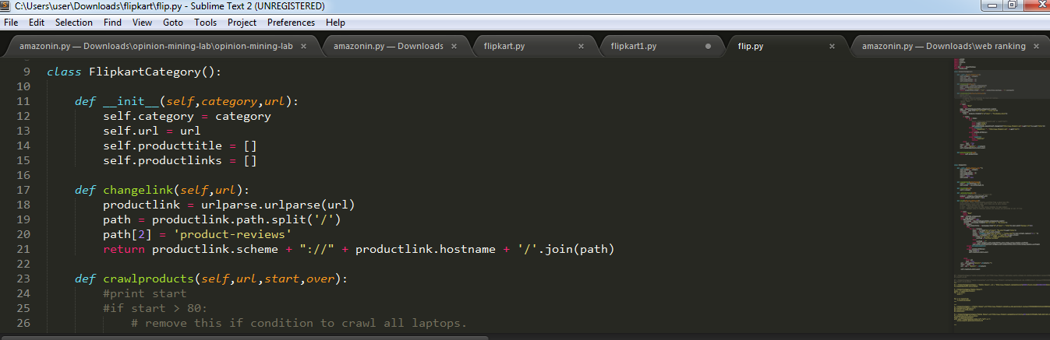
Ranking of Products using Opinion Mining on Authentic Reviews
CODE IMPLEMENTATION
Dept. of IT, Easwari Engineering College
19
Notes:
19
19

Slide 20
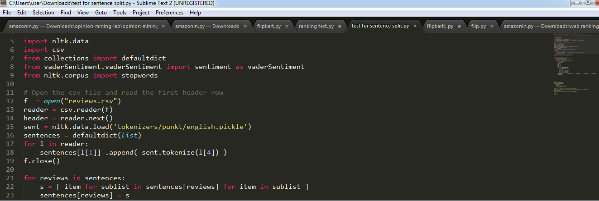
Ranking of Products using Opinion Mining on Authentic Reviews
CODE IMPLEMENTATION
20
Dept. of IT, Easwari Engineering College
Notes:
20
20

Slide 21
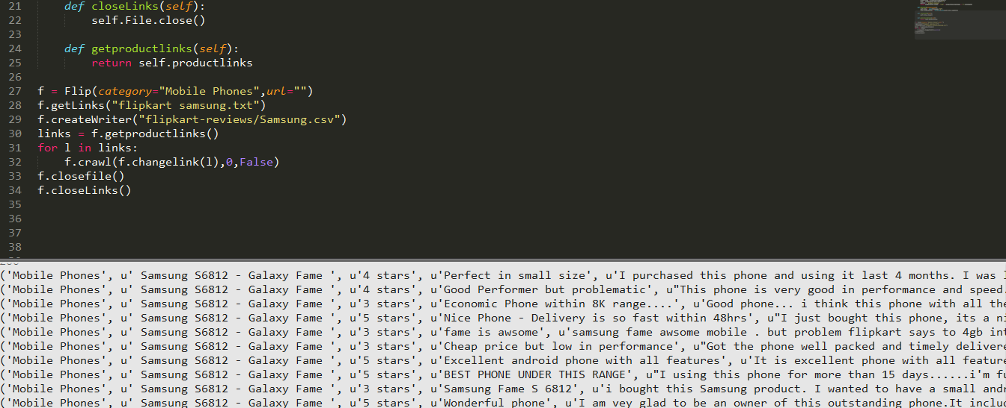
Ranking of Products using Opinion Mining on Authentic Reviews
RESULTS OBTAINED
Dept. of IT, Easwari Engineering College
21
Notes:
21
21

Slide 22
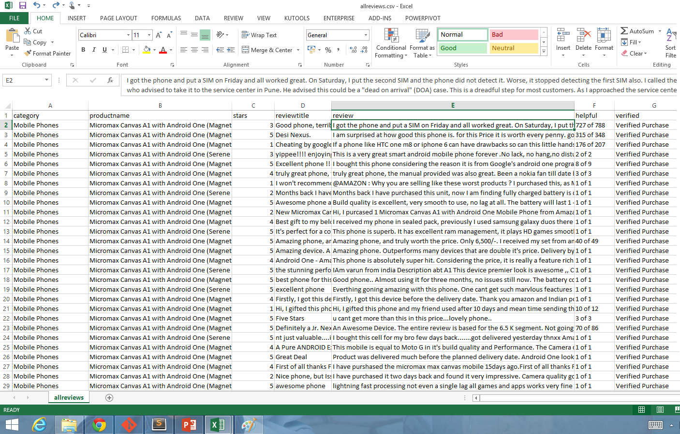
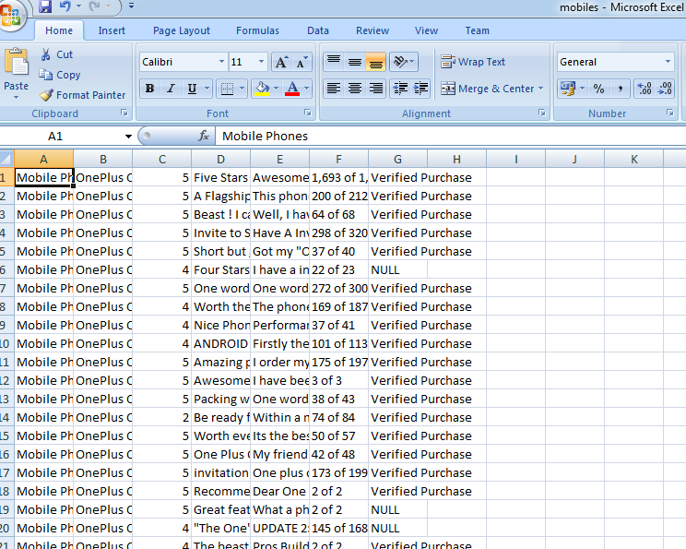
Ranking of Products using Opinion Mining on Authentic Reviews
RESULTS OBTAINED – DATA SET
Dept. of IT, Easwari Engineering College
22
Notes:
22
22

Slide 23
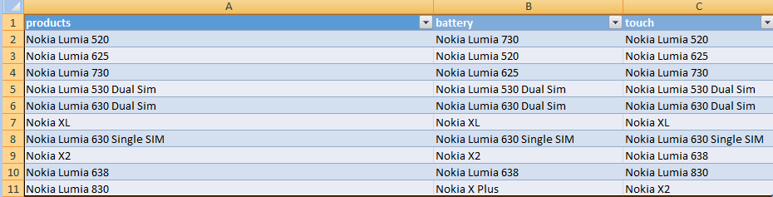
Ranking of Products using Opinion Mining on Authentic Reviews
RESULTS OBTAINED
Figure shows the results by ranking generally and ranking by aspects ( our method )

Slide 24
Ranking of Products using Opinion Mining on Authentic Reviews
RESULTS OBTAINED
Figure 5.4 Performance of the proposed system based on aspect: Touch screen

Slide 25
Ranking of Products using Opinion Mining on Authentic Reviews
CONCLUSION
The project work presents a product ranking system based on aspects of the product.
The importance of various aspects of a product from numerous reviews was inferred.
We performed opinion mining at aspect level. We find that querying products by aspects will retrieve effective results and also relevant products based on the user’s needs.
The products are ranked based on the aspects according to the review scores.
Experimental results have demonstrated the effectiveness of the proposed approaches.
Dept. of IT, Easwari Engineering College

Slide 26
Ranking of Products using Opinion Mining on Authentic Reviews
REFERENCES
[1].A. Ghose and P. G. Ipeirotis,“Estimating the helpfulness and economic impact of product reviews: Mining text and reviewer characteristics,” IEEE Trans. Knowl. Data Eng., vol. 23, no. 10, 1498–1512. Sept. 2010.
[2].V. Gupta and G. S. Lehal, “A survey of text summarization extractive techniques,” J. Emerg. Technol. Web Intell., vol. 2, no. 3, pp.258–268, 2010.
[3].W. Jin and H. H. Ho, “A novel lexicalized HMM-based learning framework for web opinion mining,” in Proc. 26th Annu. ICML, Montreal, QC, Canada, 2009, pp. 465–472.
[4].M. Hu and B. Liu, “Mining and summarizing customer reviews,” in Proc. SIGKDD, Seattle, WA, USA, 2004, pp. 168–177.
[5].B. Liu, M. Hu, and J. Cheng, “Opinion observer: Analyzing and comparing opinions on the web,” in Proc. 14th Int. Conf. WWW, Chiba, Japan, 2005, pp. 342–351.
Dept. of IT, Easwari Engineering College

Slide 27
Ranking of Products using Opinion Mining on Authentic Reviews
REFERENCES(Contd.)
[6].B. Liu, “Sentiment analysis and subjectivity,” in Handbook of Natural Language Processing, New York, NY, USA: Marcel Dekker, Inc., 2009.
[7].B. Liu, Sentiment Analysis and Opinion Mining. Mogarn & Claypool Publishers, San Rafael, CA, USA, 2012.
[8].L. M. Manevitz and M. Yousef, “One-class SVMs for document classification,” J. Mach. Learn., vol. 2, pp. 139–154, Dec. 2011.
[9].Q. Mei, X. Ling, M. Wondra, H. Su, and C. X. Zhai, “Topic sentiment mixture: Modeling facets and opinions in weblogs,” in Proc. 16th Int. Conf. WWW, Banff, AB, Canada, 2007,pp. 171–180.
[10].B. Ohana and B. Tierney, “Sentiment classification of reviews using SentiWordNet,” in Proc. IT&T Conf., Dublin, Ireland, 2009.

